Slide 1

Bank Marketing Analysis
Predicting Customer Subscription with Decision Tree Classifier
Using machine learning to transform telephone marketing from spray-and-pray outreach into precision-targeted campaigns.
DATA ANALYTICS PROJECT
APRIL 2026

Slide 2
Project Overview
45K
16
Customer Records
Input Features
UCI Machine Learning Repository dataset from Portuguese bank campaigns
Demographics, financial status, and campaign behavior variables
89.9%
0.90
Model Accuracy
ROC-AUC Score
Strong performance on held-out test data
Genuine discriminative power despite class imbalance
Tools: Python (scikit-learn, pandas) | Dashboard: Microsoft Power BI

Slide 3
The Business Challenge
The Problem
The Solution
Telephone marketing campaigns waste resources on low-probability customers. Without intelligent targeting, 88% of calls result in rejection.
Replace volume-based outreach with intelligence-driven targeting using machine learning to score customers by subscription probability.
The cost: Burned budget, agent morale, and customer irritation.
Identify high-conversion customers before calling
Maximize campaign ROI with precision targeting
Extract actionable insights from customer data

Slide 4

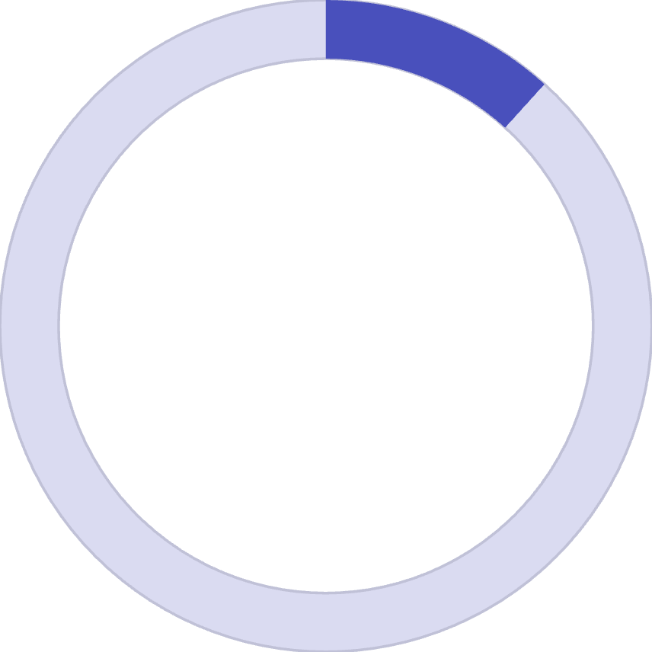

The Class Imbalance Challenge
88.3%
11.7%
Non-Subscribers
Subscribers
39,922 customers did not subscribe to term deposits
5,289 customers subscribed — approximately 7.5:1 ratio
Why this matters: A naive model predicting "no" for every customer would achieve 88% accuracy without learning anything useful. ROC-AUC of 0.90 confirms our model genuinely learned to identify subscribers.

Slide 5
Model Performance Results
89.9%
Commercial Impact
The model achieves a 60% hit rate on flagged customers versus an 11.7% base rate from random calling.
Accuracy
That's a 5x improvement in campaign efficiency — the bank needs 5x fewer calls to reach the same number of subscribers.
Correctly classified 9 in 10 customers
0.90
ROC-AUC
Strong discriminative power
60%
Precision
When model predicts subscription, correct 60% of time
40%
Recall
Captures 40% of all actual subscribers

Slide 6
What Drives Subscription?
Top 5 Predictive Features
1
Call Duration
48% importance — Calls over 300 seconds signal genuine interest. The single most powerful predictor by wide margin.
2
Contact Month
14% importance — March, September, October, December show dramatically higher conversion. Campaign timing is controllable.
3
Contact Type
11% importance — Cellular phone contact significantly outperforms landline telephone.
4
Days Since Last Contact
8% importance — Recent prior engagement increases receptiveness.
5
Housing Loan Status
6% importance — Customers without housing loans have more disposable capital.

Slide 7



Customer Demographic Insights
Age: U-Shaped Pattern
Job Type Variation
Previous Success = Future Success
Students and retired customers exhibit highest conversion. Management professionals above average. Blue-collar and services show lowest rates.
Youngest (18-25) and oldest (66+) segments show highest subscription rates. Middle-aged customers (36-55) show lowest rates due to competing financial commitments.
65% conversion rate for customers with previous successful subscription — nearly 6x the base rate. The strongest segmentation signal.

Slide 8
Strategic Recommendations
01
02
03
Re-engage Previous Subscribers First
Deploy Model as Pre-Campaign Scoring Tool
Schedule Campaigns for High-Conversion Months
Build dedicated track for customers with prior success. This segment converts at 65% — prioritizing 200 of them generates more subscriptions than cold-calling 1,500 unqualified prospects.
Score all prospects through decision tree, rank by probability. Focus calling team on customers above 40% threshold to transform hit rate from 11.7% to 40-60%.
Reallocate volume from May-July to March, September, October, December. Rescheduling costs nothing and materially improves conversion.
04
05
Train Agents on Duration Signals
Prioritize Cellular Contact
Calls approaching 5 minutes represent high-conversion opportunities. Agents should invest more effort extending these calls rather than moving to next customer.
Default to cellular outreach where contact method is flexible. Update CRM to flag preferred contact method for compounding advantage.

Slide 9

Methodology & Technology
Analytical Pipeline
Key Technical Decisions
Stratified sampling: Preserved 88/12 class ratio in train-test split
ROC-AUC optimization: Insensitive to class imbalance, measures true discriminative power
Hyperparameter tuning: GridSearchCV across 224 combinations with 5-fold cross-validation
Optimal depth: Max depth of 10 vs baseline 29 controlled overfitting
Performance Evaluation
Model Training
Train models with GridSearchCV tuning.
Assess metrics using stratified splits.
Data Preprocessing
Power BI Dashboard
Clean, impute, and encode features.
Publish interactive reports for stakeholders.
Python handled ML heavy lifting while Power BI enabled interactive business intelligence for non-technical stakeholders.

Slide 10
Conclusion
Can machine learning meaningfully improve the bank's ability to identify customers who will subscribe before a single call is made? The answer is an unambiguous yes.
This project delivered a reliable predictive tool with 0.90 ROC-AUC, fully interpretable decisions, and actionable recommendations. The findings reveal durable intelligence about customer behavior that will remain true beyond this quarter.
The Power BI dashboard ensures analytical work doesn't remain locked in notebooks — it places intelligence directly in the hands of decision-makers with authority to act.
Prepared by: Abiola Aderemi | Python (scikit-learn, pandas) | Microsoft Power BI | April 2026

